Slide 1
Selma-Irwin Bike Trail Expansion
By Matthew Davis Beal

Slide 2
Problem Statement
The Selma-Irwin Nature Trail is a 4 ½ mile long trail used by both hikers and bikers alike. It is a notoriously difficult trail, however, and thus many people are either scared off, or come once and then never again. This is truly a shame because it is a fantastic trail with an excellent view of nature. The question is how to make the trail more accessible to less experienced people. The completion of this goal would bring more people to the trail.

Slide 3
Methodology
Data Acquisition:
The Baldwin County base map, DEM and map of the original trails were acquired from the GCSU Geographic Research Commons.
The paper map used to georeference the new trails was made by Bud Merritt, associated with the
GIS Usage:
I used the software to georeference the paper map to the correct spatial dimensions. This was used to digitize the new trails into the old trail data.
I then input the 3D information from the DEM onto the trail using the interpolation tool. This was then used to create a 3D terrain model in ArcScene.
From this, I extracted graphs using the Create Profile Graphs tool that showed terrain height changes
Finally I digitized several new trails based on elevation gain and loss for different skill levels of cycling and hiking abilities.

Slide 4
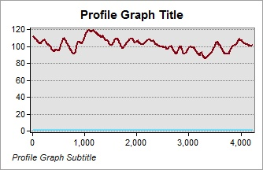
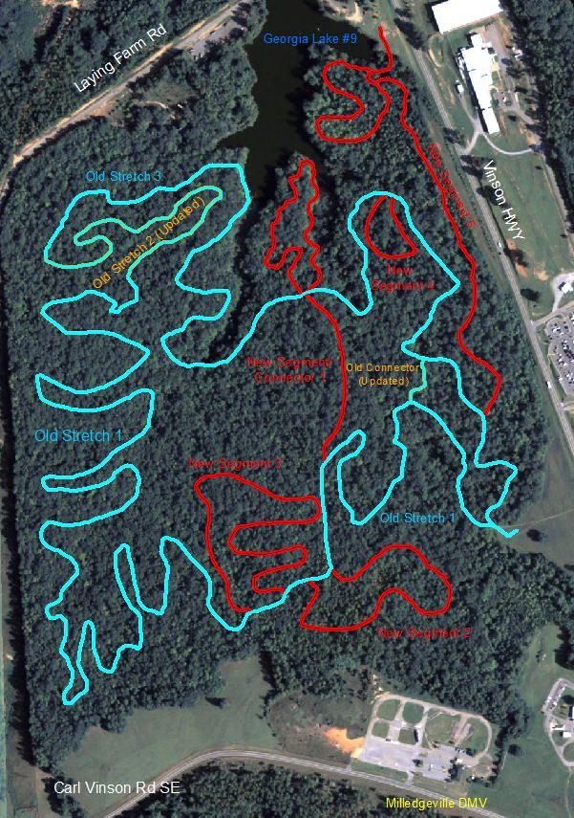
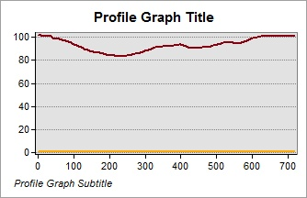
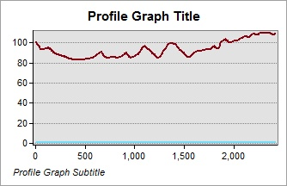
Analysis
Old Trails Height Gain and Loss
Old Stretch 1
From the graphs, it can be observed that there are regular changes of elevation, which would make it difficult on new or less experienced hikers or bikers.
As seen on the following slide, however, the proposed new trails follow gently sloping or even flat line trends for a majority of their length. This would allow different levels of proficiency to take on a challenge more apt to their level.
New Segment 2
Old Stretch 2
New Segment 3
Old Stretch 3
Old trails highlighted in Blue

Slide 5
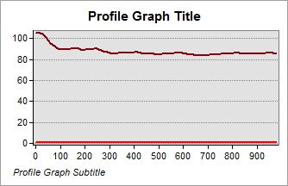
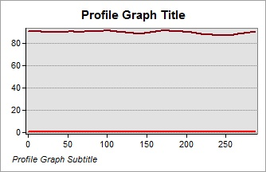
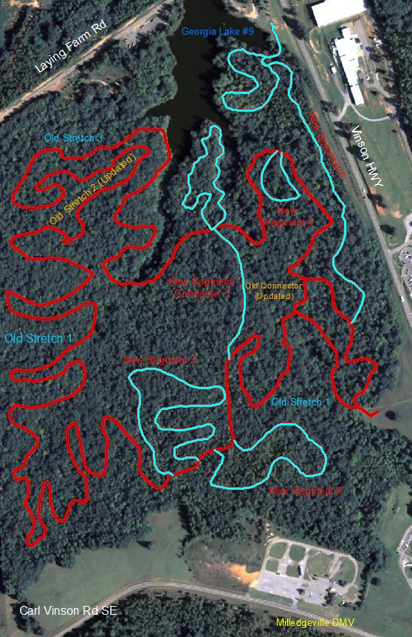
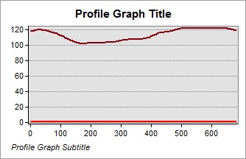
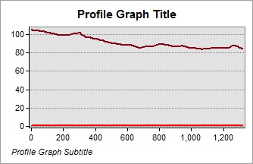
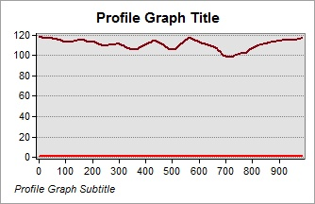
Analysis
New Trails Height Gain and Loss
New Segment 1
New Segment 4
New Segment 2
New Segment 5
New Segment 3
Note the absence of sharp increases or decreases of elevation in the above graphs.
New Trails Highlighted in Blue

Slide 6
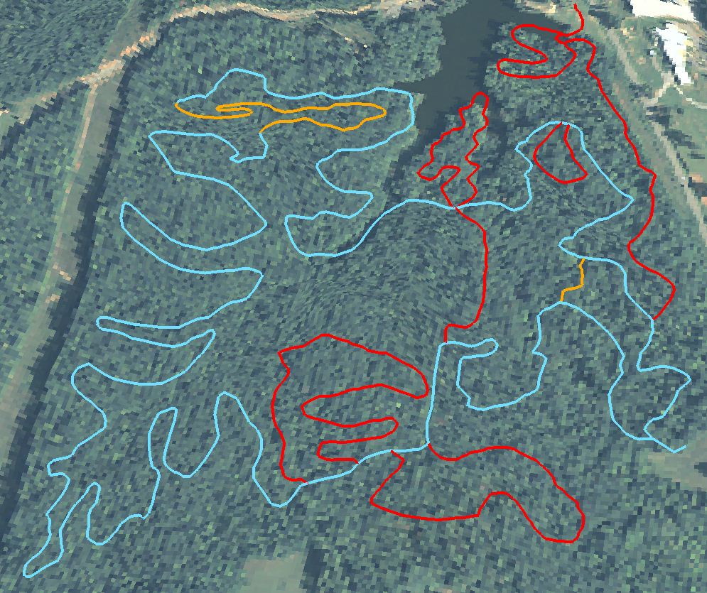
Analysis
The above image is a 3D rendering of the trail with exaggerated peaks and valleys to show the extent of the terrain change along the trails.

Slide 7
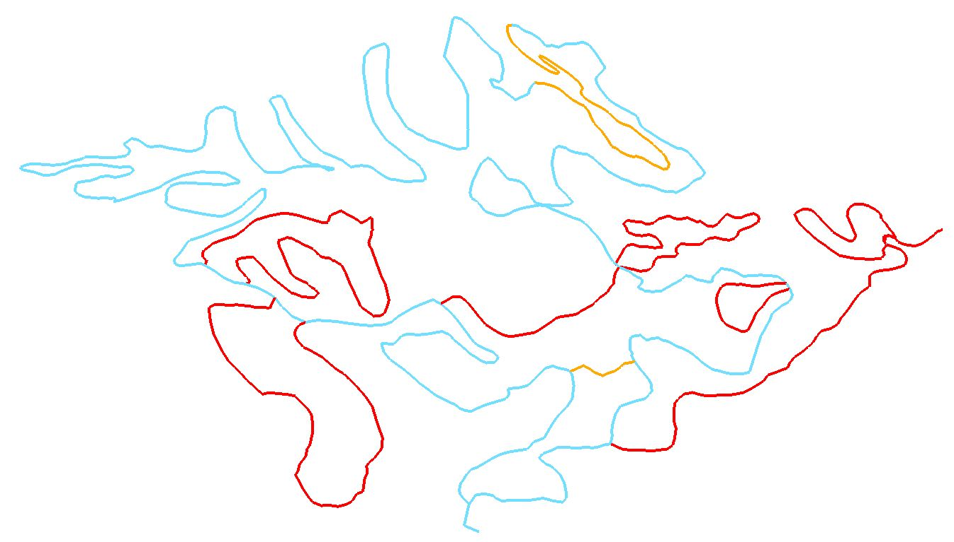
Analysis
The above is the 3D model without the base map to further show the elevation difference around the area.
Below is a side view to show the same point.
Notes:
May look kind of messy, but if you look at all the red lines (new trails) in the bottom picture, and the blue lines (old trails), you can tell that there is a massive change in the stability of the lines.

Slide 8
Results
The results show that the new trails would be a perfect way to make the trails more accessible to all people.
I have mapped several different examples of trails of varying degrees of difficulty that people could take.
With the new trails, there would be something for every skill level, and would make the trail something a family could do together.
The following slides are just a few of many possible combinations of routes that could be taken to adjust the level of challenge.
The easier courses should seek to maximize use of the newer trails to take advantage of their more stable elevation, while the advanced could use a combination of old and new trails to obtain the desired challenge.

Slide 9
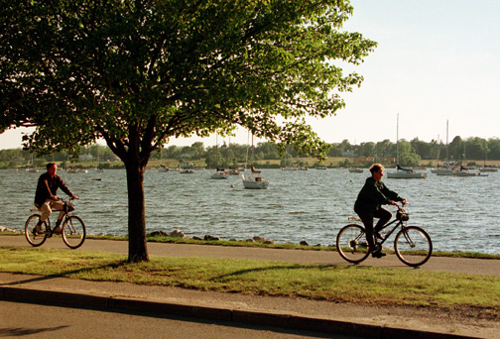
Beginner

Slide 10
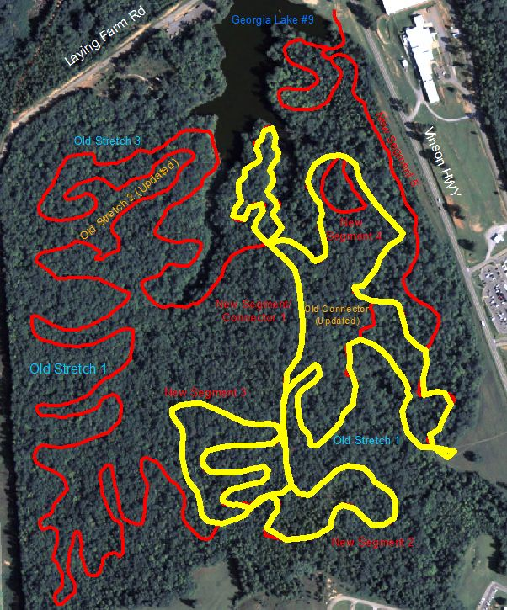
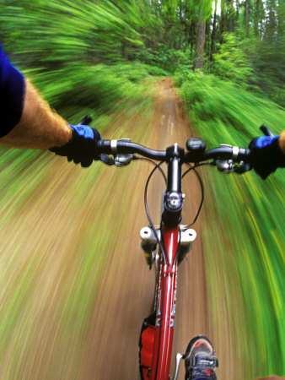
Intermediate

Slide 11
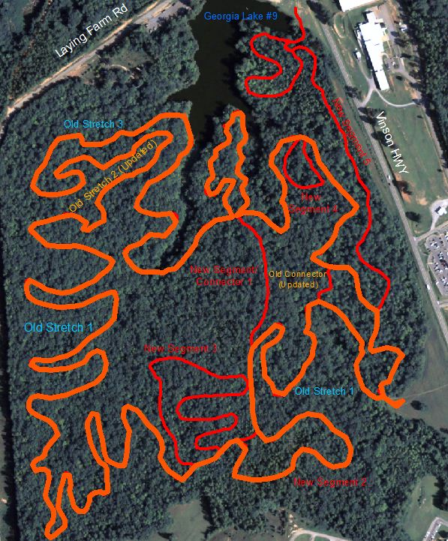
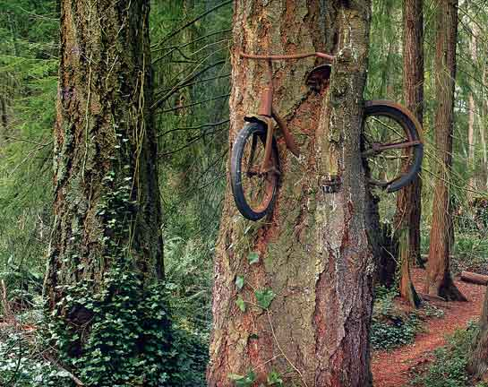
Advanced

Slide 12
Conclusions
The Selma-Irwin Trail is a great trail, with fantastic scenery.
It is currently a notoriously difficult trail due to the rapidly changing elevation and rough terrain which can intimidate would be users.
A series of trail expansions have been mapped out which would offer easier alternatives for other prospective trail goers.
The location of these trails have very flat or gently sloping terrain.
This is a great addition to the trail because it would make it accessible to more people, and expand it for the more advanced users

Slide 13
Scholarly Resources
Ehlers, Manfred, Stefan Jung, and Katrin Stroemer. "Design and Implementation of a GIS Based Bicycle Routing System for the World Wide Web (WWW)." International Archives of Photogrammetry Remote Sensing and Spatial Information Sciences 34.4 (2002): 425-429.
Wigglesivorth, John C. "What is the best route? Route-finding strategies of middle school students using GIS." Journal of Geography 102.6 (2003): 282-291.

