Slide 1
Gis project
Mapping Bartram Forest Nav Points, Trails, and Other Features
Matt Beal

Slide 2
Problem statement
Bartram Forest has an extensive trail system along with navigation points for a Land Navigation Course used by cadets at GMC. The problem is that there is no map that reliably maps these without first having to locate the points using a protractor. Currently instructors use a standard topographic map without any reference to the trails around the forest or the Land Navigation points whatsoever. My goal was to create a topographic map using the existing model while adding in the necessary data to make the map easier to read in the way of finding these points and other features such as power lines, fire breaks, ponds, etc…

Slide 3
Data Acquisition and pre-processing
The first step I took was to gather data. This was done from various resources.
I used the GCSU Geographic Research Commons to acquire the various shapefiles and coordinate systems that I used during the map making process.
I acquired the topographic maps I used from the GIS Data Clearing House (https://data.georgiaspatial.org)
I acquired portions of the metadata on the map such as the legend from the Tenino map produced by the Defense Mapping Agency
Once I acquired all of this data, I grouped the necessary shapefiles together using the merge tool and projected everything into the same coordinate system.
I then arranged my data into the necessary locations on the map and fixed the symbology to look appealing.

Slide 4
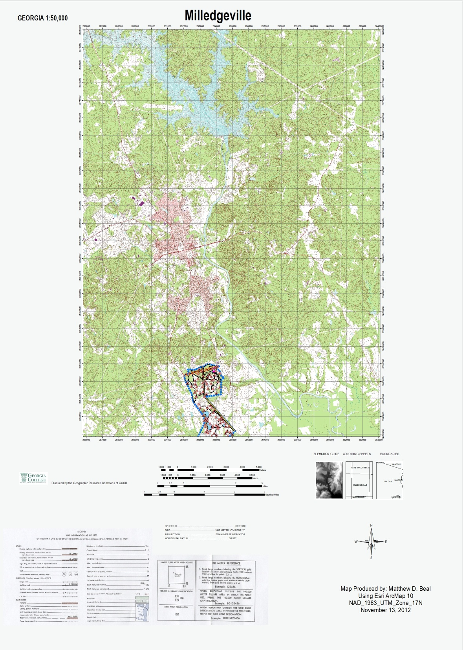
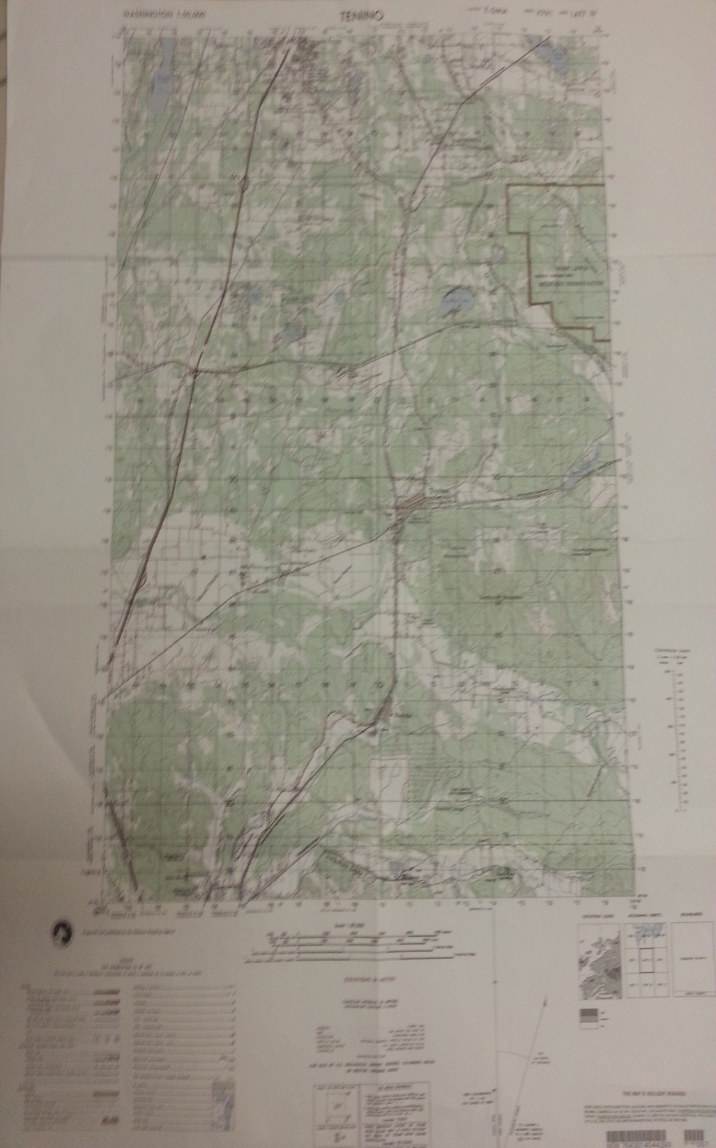

Slide 5
Data Analysis
For my analysis, I will be comparing the map I made to the map of Tenino. The largest discernible difference is the fact that the map I produced has far more detail of use to those who wish to use the trails of Bartram Forest or to quickly locate a Land Navigation point without having to resort to using a protractor. The map also includes details of other key features throughout Bartram Forest such as the power line, fire break, ponds, and the pavilion. These features would not be displayed on the official topographic map of the Milledgeville region.

Slide 6
Results
The results reached is that of a map that would be extremely beneficial for anyone who wished to possess complete detailing of the land navigation points, trails, and other features of Bartram forest. There is currently no map that holds all of this information. It would be of particular benefit to the instructors of the Bartram Forest Land Navigation Course.

